Slide 1
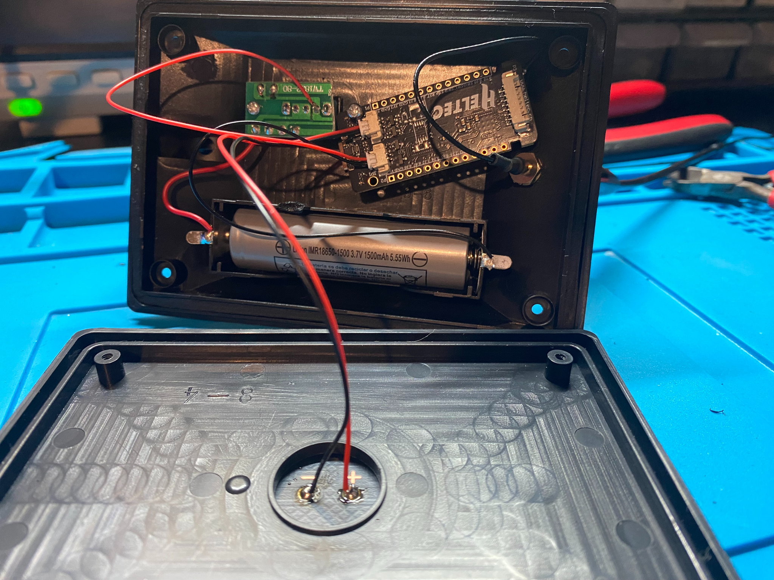
mesh hack tricks
prepared by Danielle McGuire
for BSidesPGH 2026

Slide 2
Thank you to the Protomesh Collective and our collaborators!!
Alpine Creature
Brynn Flowers
Creative Chemical
Emi
Giselle J
Green Dragon House
Greyfox
Jamie Werger
Katelyn Chirdon
Milkweed
Rushi Null
Prototype Makerspace
Sunbear

Slide 3
agenda
Intro
What is Meshtastic?
DEMO - Sniffing Wireless Meshtastic Traffic with an RTL-SDR
Radio 101
Why Meshtastic?
Why not Meshtastic?
DEMO – Spoofing Hardware IDs to Exploit Lack of Authentication in Meshtastic Protocol
Building Meshtastic nodes for cheap
DEMO – Programmatic Control via Meshtastic SDK
Monitoring Meshtastic networks
Conclusion

Slide 4
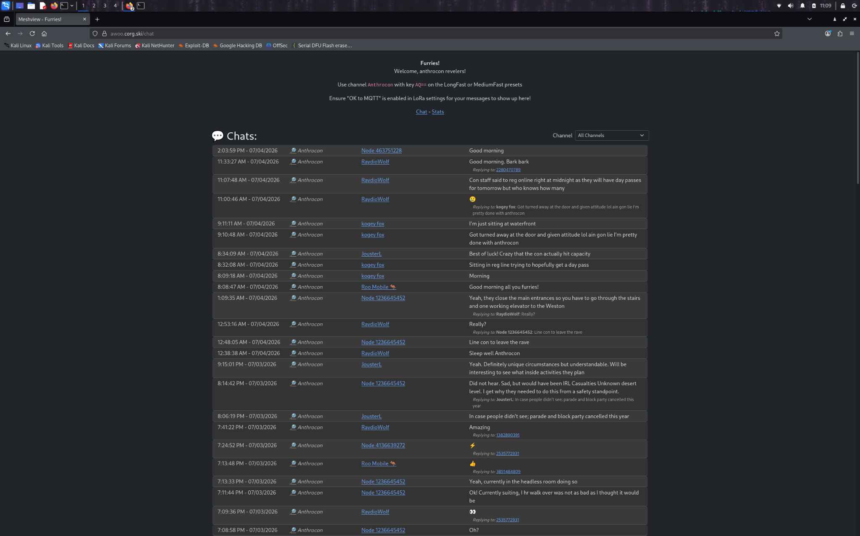

Slide 5
i’m about to try and make you as excited about radio as i am. i’m going to tell you about all the amazing and beautiful things happening on the 915MHz (33cm) band and how you can be a part of them.

Slide 6
i’m about to try and make you as excited about radio as i am. i’m going to tell you about all the amazing and beautiful things happening on the 915MHz (33cm) band and how you can be a part of them.

Slide 7
i’m about to try and make you as excited about radio as i am. i’m going to tell you about all the amazing and beautiful things happening on the 915MHz (33cm) band and how you can be a part of them.

Slide 8
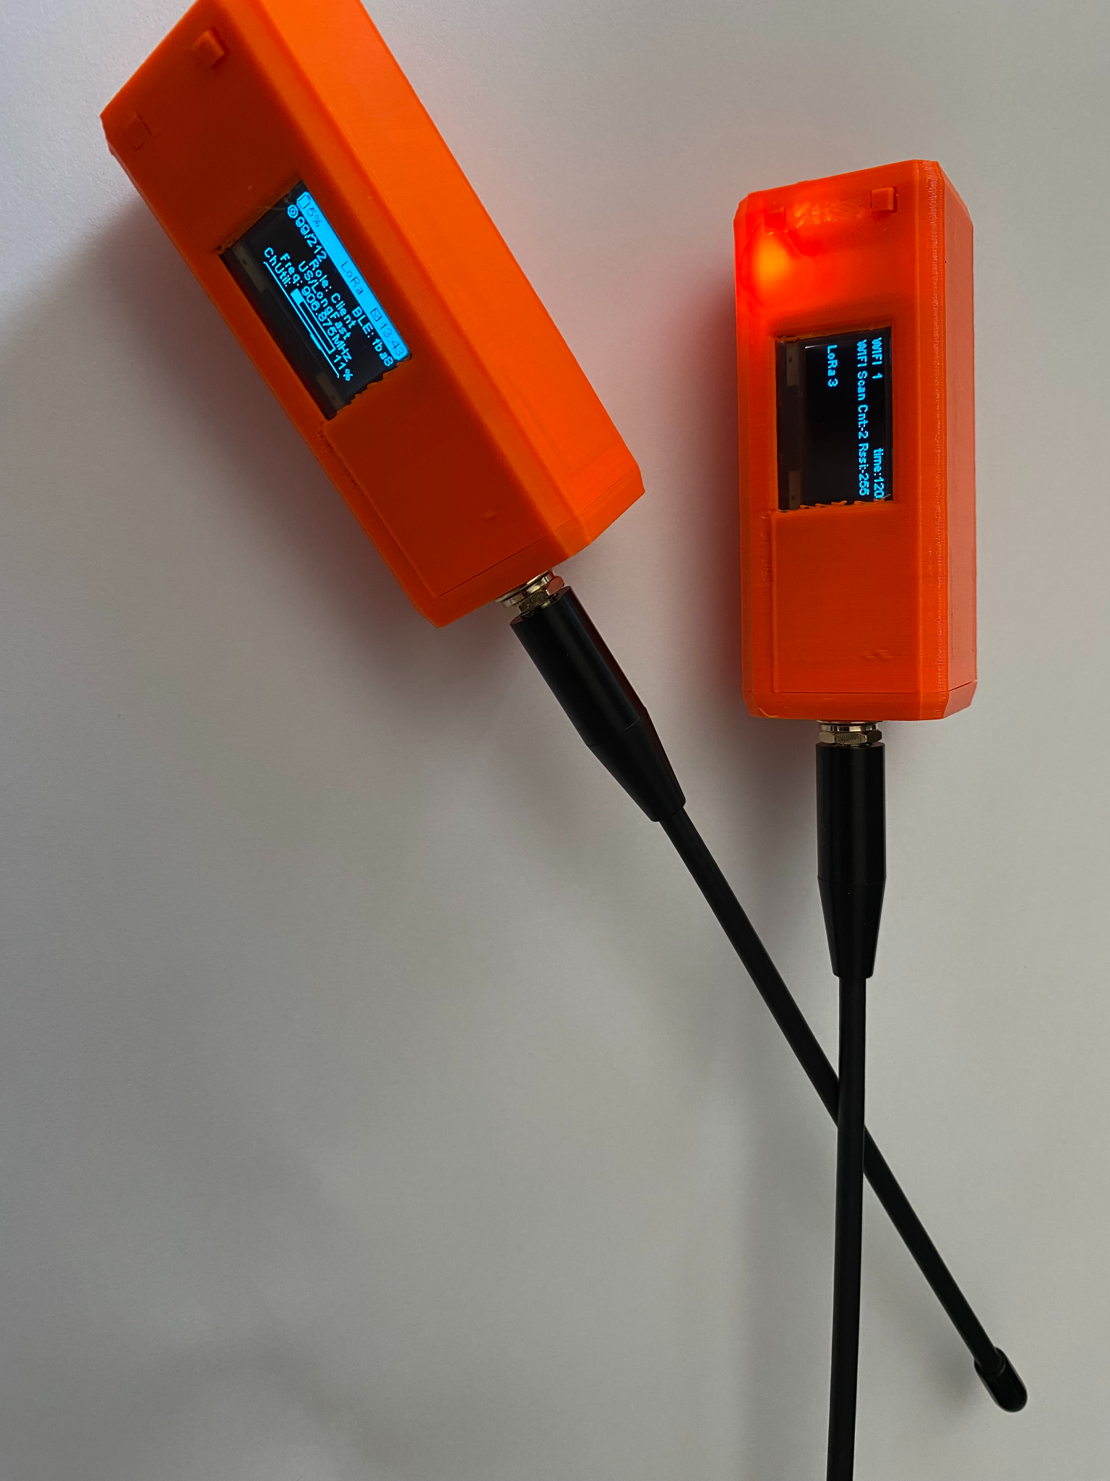
what is meshtastic?
MESH HACK TRICKS: Building and Breaking Encrypted Off-Grid Messaging / Danielle McGuire / BSidesPGH 2026
An open source, off-grid, decentralized mesh network built to run on affordable, low-power devices. No cell towers. No internet. Just pure peer-to-peer connectivity.
front page of https://meshtastic.org
an encrypted communications network that can reliably function without the Internet, cellular infrastructure, satellites, or even the power grid - when all else fails, there’s the 915

Slide 9
under the hood
MESH HACK TRICKS: Building and Breaking Encrypted Off-Grid Messaging / Danielle McGuire / BSidesPGH 2026
Physical layer - wireless LoRa-modulated radio waves over suitable unregulated frequency band (915MHz/33cm is designated for ‘Industrial, Scientific or Medical’ usage by the US FCC)
Application Layer - lots of choices!
LoRaWan - Internet WAN for IoT
Meshtastic – resilient encrypted decentralized text messaging (simple)
Meshcore – resilient encrypted decentralized text messaging (powerful)
Reticulum - Crypto-first physical- medium-agnostic decentralized Internet of the future

Slide 10
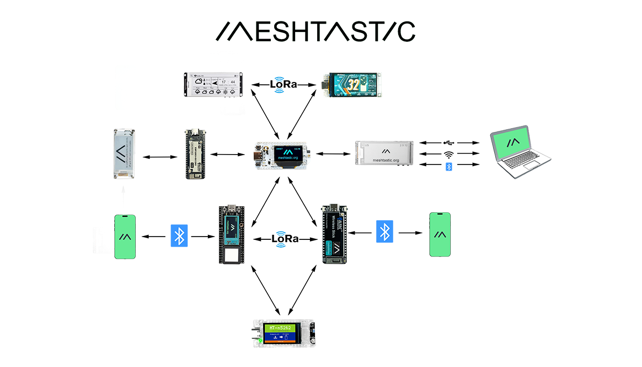
diagram taken from https://heltec.org/eadge-computing/

Slide 11
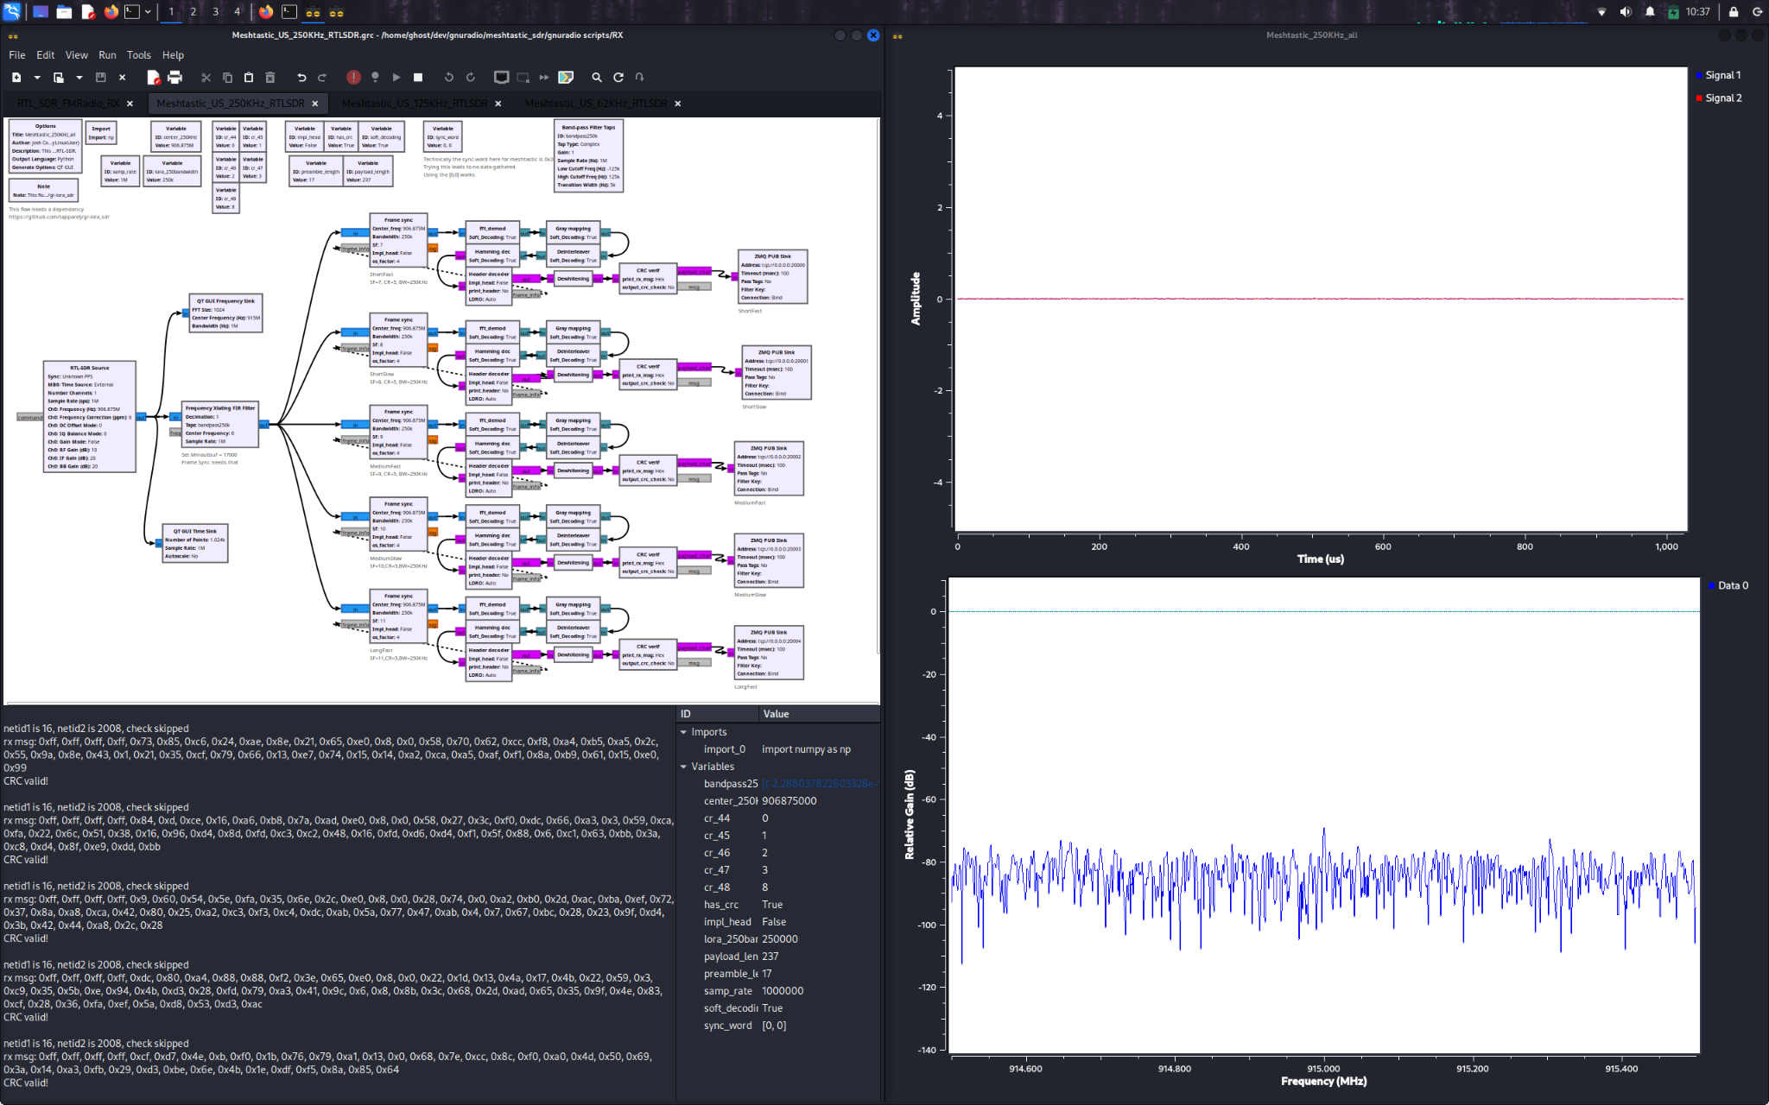
DEMO -
Wirelessly
Sniffing Meshtastic Traffic with an RTL-SDR

Slide 12
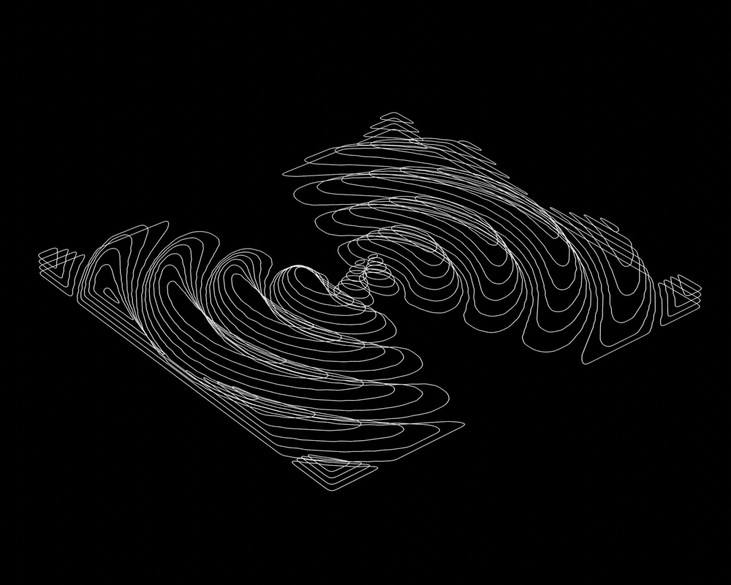
radio 101
MESH HACK TRICKS: Building and Breaking Encrypted Off-Grid Messaging / Danielle McGuire / BSidesPGH 2026
a radio transmitter (TX) is a photon gun, constantly emitting electromagnetic radiation at a desired frequency.
the speed of the wave equals the frequency of the wave times the wavelength
1 hertz (Hz) = 1 cycle/second
= 1 wave/second
1 megahertz (MHz) = 1,000,000 Hz
like all electromagnetic radiation, radio waves travel at the speed of light (300,000,000 m/s in vacuum)
(Wavelength in meters) *
(Frequency in MHz) = 300
divide 300 by one to get the other
Animation of radio waves from dipole antenna
rippling through 3D space (https://blender.stackexchange.com/questions/304616/creating-an-animation-of-radio-waves)

Slide 13
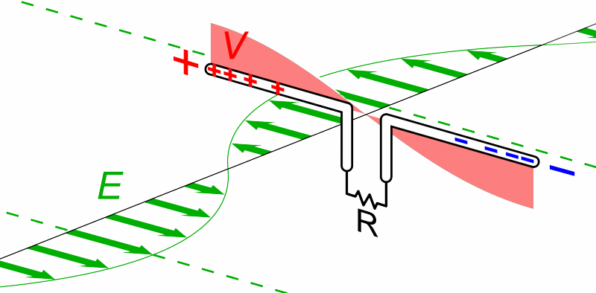
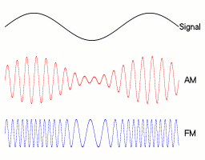
radio 101
MESH HACK TRICKS: Building and Breaking Encrypted Off-Grid Messaging / Danielle McGuire / BSidesPGH 2026
a radio antenna tuned to the right frequency can receive the electromagnetic wave and convert it into electric current
a radio receiver (RX) is a circuit that decodes the information encoded in the received wave, and processes/outputs that information
some ways to encode information in a carrier wave:
Amplitude Modulation (AM)
Frequency Modulation (FM)
LoRa (too complex to draw easily, but it’s just another way to encode information!)
Top - https://upload.wikimedia.org/wikipedia/commons/e/ea/Dipole_receiving_antenna_animation_6_300ms.gif
Bottom - https://en.wikipedia.org/wiki/Frequency_modulation

Slide 14
Why Meshtastic?
MESH HACK TRICKS: Building and Breaking Encrypted Off-Grid Messaging / Danielle McGuire / BSidesPGH 2026
[vs Signal] resilient and decentralized
[vs ham radio] relatively cheap, encrypted and no license required
cheap radio experimentation platform whose potential is maybe 1% explored
novel comms technique that’s SUPER easy to hack!!

Slide 15

Why Not Meshtastic?
MESH HACK TRICKS: Building and Breaking Encrypted Off-Grid Messaging / Danielle McGuire / BSidesPGH 2026
known limitations of Meshtastic security model (https://meshtastic.org/docs/about/overview/encryption/limitations/):
No authentication
Unattended nodes are insecure
No perfect-forward secrecy
reliability concerns
current limitations of client software
Meshtastic is great for building a new 915MHz mesh network, Meshcore is better for efficiently using an established network
TL;DR - we are building comms that work when all else fails
Use Signal for E2EE
Use established comms for critical matters
Learn how Meshtastic/Meshcore/LoRa works before all else fails!

Slide 16
DEMO -
Spoofing Node Hardware ID

Slide 17
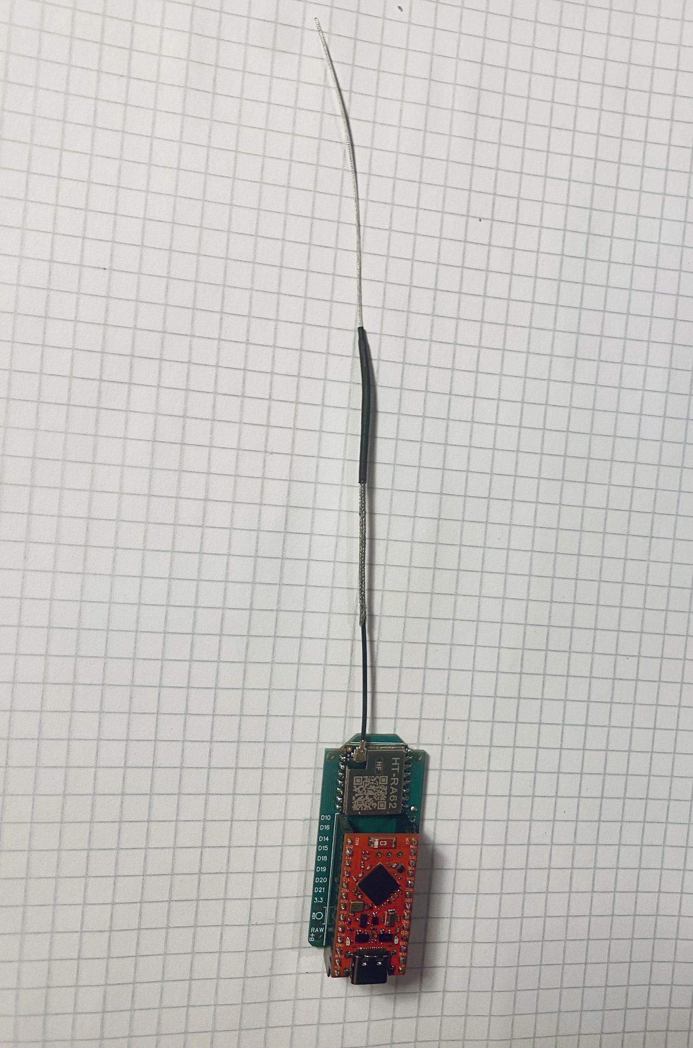
Building Meshtastic Nodes for Cheap
MESH HACK TRICKS: Building and Breaking Encrypted Off-Grid Messaging / Danielle McGuire / BSidesPGH 2026
Hampton Bay Solar Node Hack
Use a $10 Lowe’s Solar Light for its:
1W Solar Panel
2+ Ah battery
Battery Management System
Waterproof case
FakeTec for DIY Bluetooth/LoRa
Replace an $18 Heltec T114 with $9 DIY
$2 SuperMicro NRF52840 Bluetooth “Redboard”
$4 HT-RA62 915MHz LoRa Radio
$2 green board to JLCPCB
<$1 Various 1206 surface mount components
Battery packs with 9x capacity/$ ratio
Solder JST cables to nickel strip, spot weld nickel strip to 18650
Shrink wrap tubing to hold the cable in place
LiPo thermal runaway is hellfire, use LiFePO4 if possible
Stevens Stinger v2 - Modify $1 1.13mm coaxial cable into <1.5 SWR

Slide 18
DEMO -
Controlling Nodes Programmatically via Meshtastic SDK

Slide 19
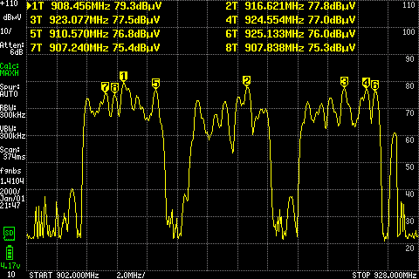
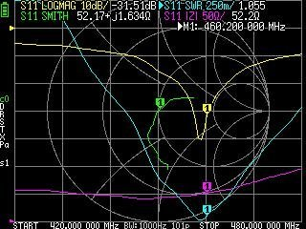
Monitoring Meshtastic Networks
MESH HACK TRICKS: Building and Breaking Encrypted Off-Grid Messaging / Danielle McGuire / BSidesPGH 2026
RF measurements with TinySA (foxhunting, spurious emissions testing) and NanoVNA (antenna quality testing)
These tools make it straightforward to build very good antennas at home!!
Give intuitive understanding of how radio waves propagate and how certain RF attacks/techniques function (triangulation)
Node admin via publickey
Shoutout – Catgirl Works Matrix Bridge, https://awoo.corg.ski

Slide 20
Monitoring Meshtastic Networks
MESH HACK TRICKS: Building and Breaking Encrypted Off-Grid Messaging / Danielle McGuire / BSidesPGH 2026
Can forward messages via MQTT
Bridge frequency presets (“Anthrocon” channel, also shown at right on https://awoo.corg.ski)
Bridge platforms (Catgirl Works Matrix Bridge bridges Meshtastic+Meshcore)
Remote node admin via node publickey

Slide 21
Conclusion
MESH HACK TRICKS: Building and Breaking Encrypted Off-Grid Messaging / Danielle McGuire / BSidesPGH 2026
Meshtastic is ultra-resilient decentralized encrypted comms currently exploding in popularity
The project/technology/effort needs experts of all kinds:
Assembling + programming nodes
Researching new node designs
Hosting onboarding workshops
Coordinating between projects
Building client software
Security testing
Whatever you’re good at, we probably need it!
Lots of great projects to join, especially here in Pittsburgh!
WPAmesh
Protomesh Collective
Hacker’s Guild

Slide 22
Thank You! Questions?
Contact me at dani@societyofhackers.com

